Slide 1



IOT Security
By
V Jaya Shravan

Slide 2
Security – What, Why, When
What?
No single definition in the literature, but broadly
Security – the state of being protected from harm
Why?
To protect from malicious intent users.
To Maintain Confidentiality
To Maintain Integrity
To Provide Authenticity
When?
When the information is Private.
When data enters the outer world for communication, analysis and processing.
Notes:
Privacy – the state of being kept away from observation

Slide 3
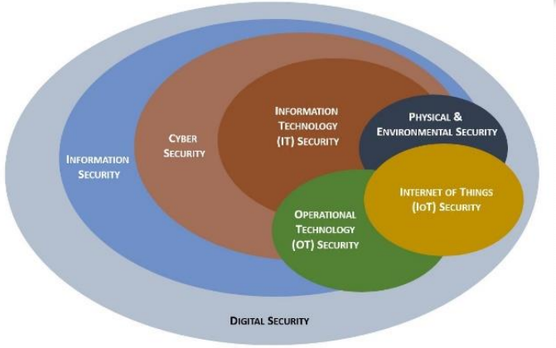
Broad View of Security

Slide 4
What is IOT Security
IOT Security = Embedded Device Security + Network Security
Protecting IOT System Resources from being harmed.
Hardware, firmware, software, cloud.
IoT Security is very important since it deals with public data, process.
IOT Security - Protects from four types of vulnerabilities
Communication attacks on the data transmitted between IoT devices and servers.
Lifecycle attacks on the IoT device as it changes hands from user to maintenance.
Attacks on the device software.
Physical attacks, which directly target the chip in the device.

Slide 5
Security – Embedded v/s IOT
Embedded System (Standalone)
Do not require a host system like a computer, it works by itself.
Ex: Mp3 players, Microwave ovens
Very Less prone to threats - Less security is needed
Wired IOT systems are moderately prone to threats.
IOT Systems (Embedded System + Network)
These types of systems needs a network to access/report/analyse/process/ a resources, to complete desired task.
The connection can be any wired or wireless.
Ex: Smart Watch, Smart microwave oven.
These systems are highly prone to threats.

Slide 6
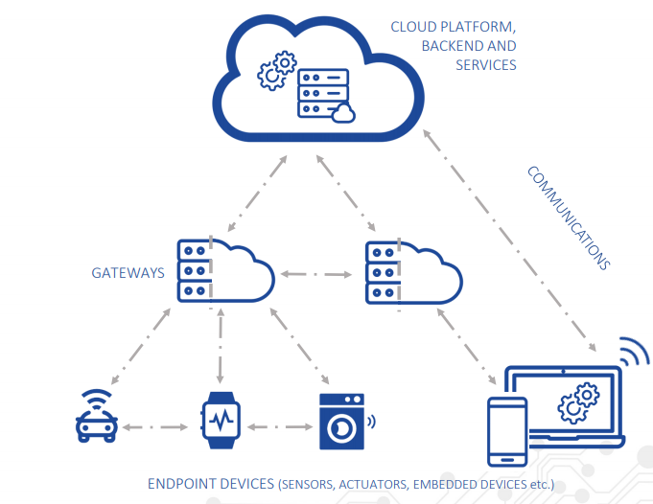
Typical IOT System

Slide 7
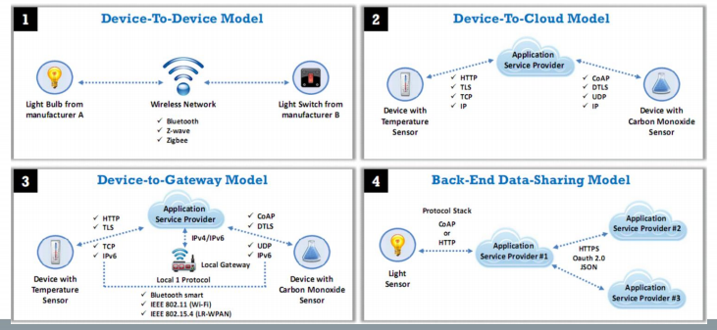
IOT Communication Models

Slide 8
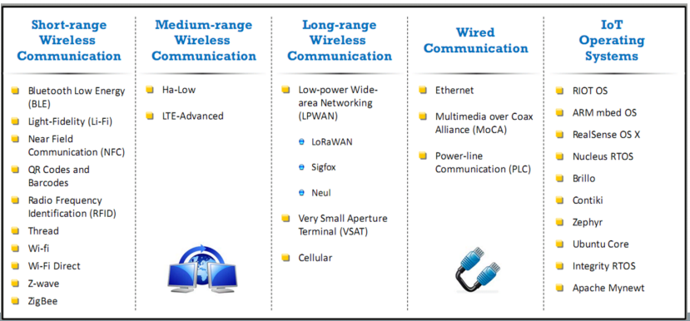
IOT Technologies and Protocols

Slide 9
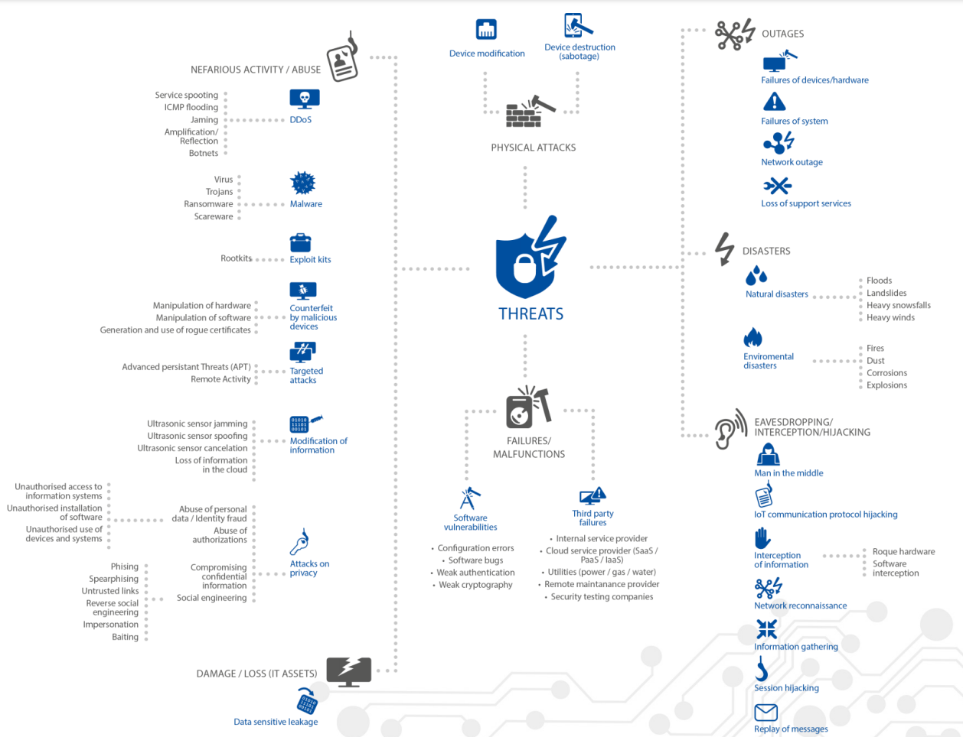
Attacks on IOT System

Slide 10
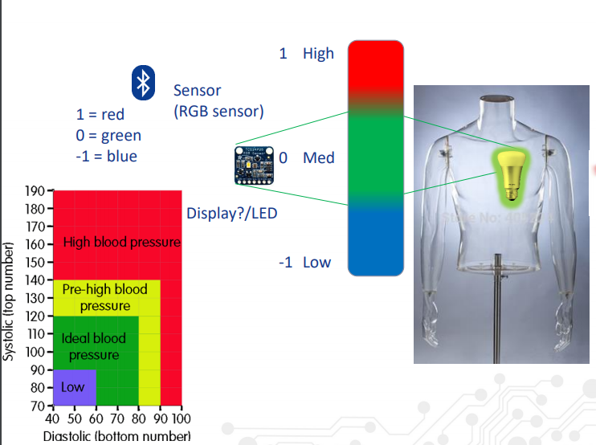
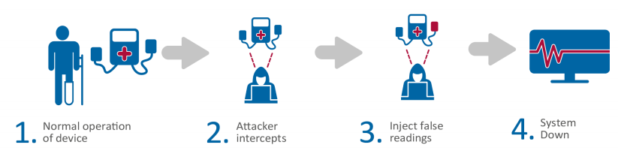
Attack Scenarios
Consider a system, which has
Heart Sensor
Bluetooth Module (Connectivity)
Raspberry PI (Decision Processing)
Pacemaker (Actuator)
MITM Attack on Pacemaker

Slide 11
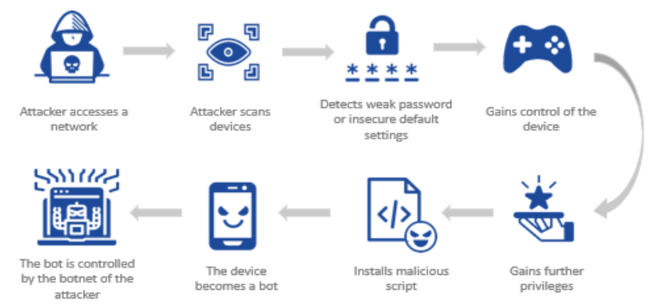

Slide 12
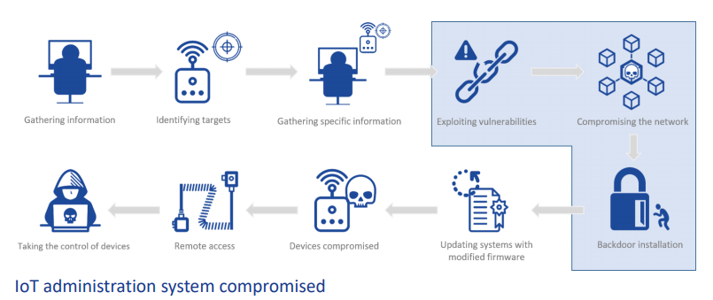

Slide 13
Providing Security for IOT System
Security majorly provided at 4 levels:
Hardware/Product Level
Protecting physically (Anti Tamper Mechanisms, Hardware Security Modules, Blockage of external interfaces, Good Housing)
Firmware Level
Encrypting the firmware, prevention of firmware rollback, memory corruption etc.
Software Level
Securing services/application (TEE, Secure Boot, H/W Assisted Protection (TPM)
Network Level
Securing Wired and Wireless Communications (TLS, Firewall, VPN, Reducing no.of open ports)

Slide 14
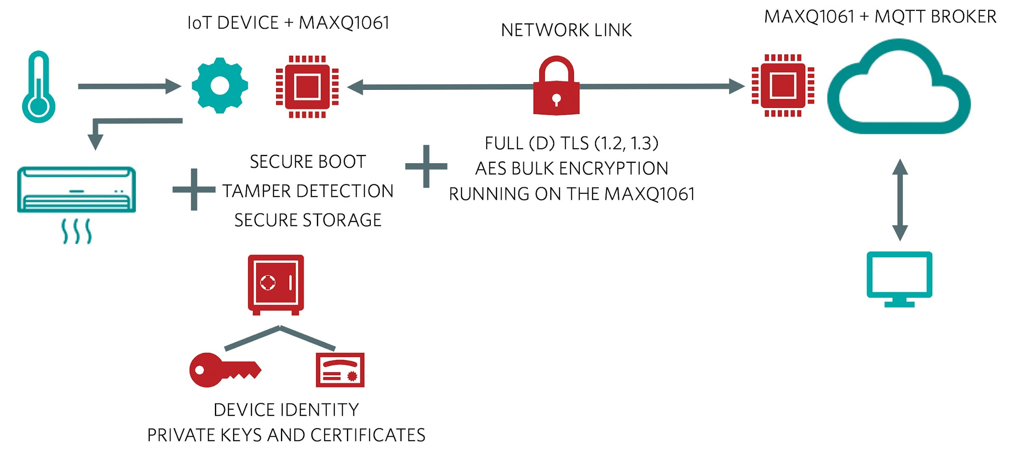
Security Implemented at different levels

Slide 15
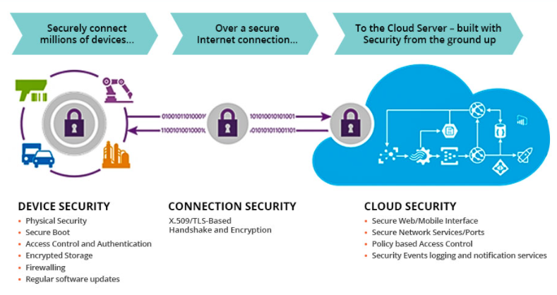
End to End IOT Security

Slide 16
Queries?

Slide 17
Thank You

